Slide 1
Project Meeting
2018.11.14

Slide 2
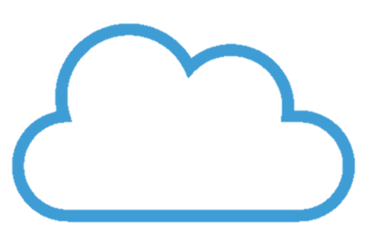

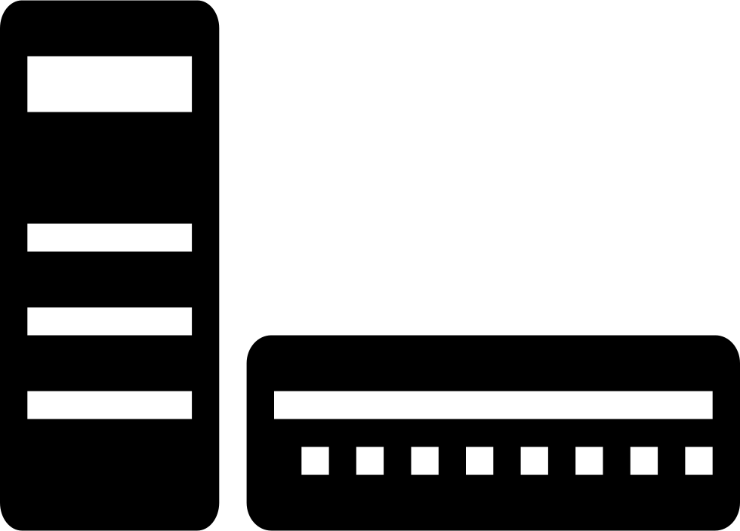

Structure
Cloud
Fog
Sensor

Slide 3



Architecture
Cloud
Deep Learning
Training Environment
Bockchain hash data
Bockchain hash data
anomaly alarm
DNN new model
anomaly alarm
DNN new model
original data
original data
container
container
Node
MQTT Broker
DNN Model
sharing ledger
MQTT Broker
DNN Model
Blockchain
Blockchain
sensor data
sensor data
Smart Meter Simulator
Smart Meter Simulator
Smart Meter Simulator
……
Sensor

Slide 4
Gateway
Raspberry Pi
LoRa
antenna
container
MQTT
Broker
LoRa
Gateway
Bridge
Message
Management program
Transmis-sion
after
DNN
program
DNN
Model
Data anomaly
behavior
program
BlockChain
Notes:
LoRa channel: 台灣使用920∼925MHz頻段的923MHz
LoRa Gateway Bridge is a service which abstracts the packet-forwarder UDP protocol into JSON over MQTT

Slide 5
Gateway protocol information
DHCP/Static IP/PPPoE
TCP
Notes:
Gateway: the intermediate devices that forward packets coming from end-devices to a network server over an IP backhaul interface allowing a bigger throughput, such as Ethernet or 3G. There can be multiple gateways in a LoRa deployment, and the same data packet can be received (and forwarded) by more than one gateway.
PPPoE（英語：Point-to-Point Protocol Over Ethernet），乙太網路上的對等協定，是將對等協定（PPP）封裝在乙太網路（Ethernet）框架中的一種網路隧道協定。
DHCP: 動態主機設定協定（英語：Dynamic Host Configuration Protocol，DHCP）是一個區域網路的網路協定，使用UDP協定工作
TCP 傳輸控制協定（英語：Transmission Control Protocol，縮寫為TCP）是一種連接導向的、可靠的、基於位元組流的傳輸層通訊協定，由IETF的RFC 793定義。

Slide 6
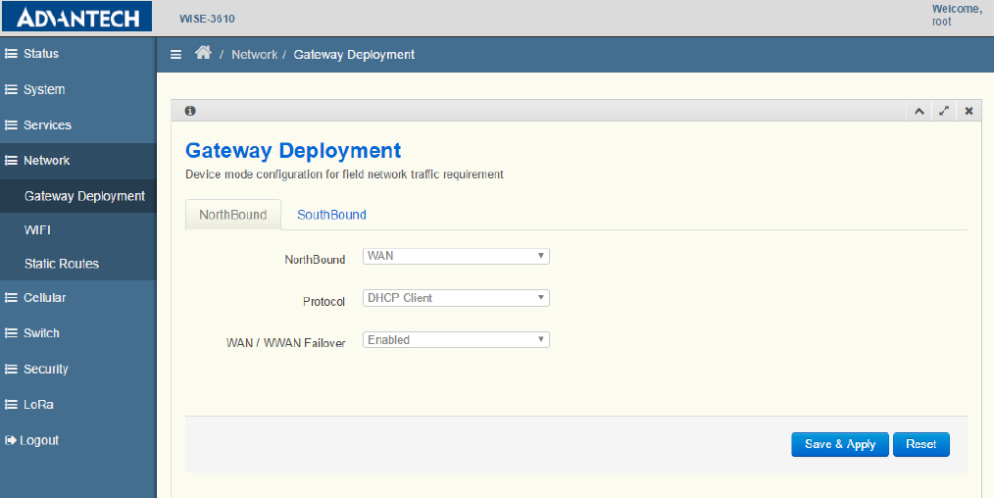
WISE-3610 Web GUI
Notes:
WISE-3610 LoRa Gateway SDK Build Procedure網關SDK構建過程(firmware)

Slide 7
Thanks

Slide 8
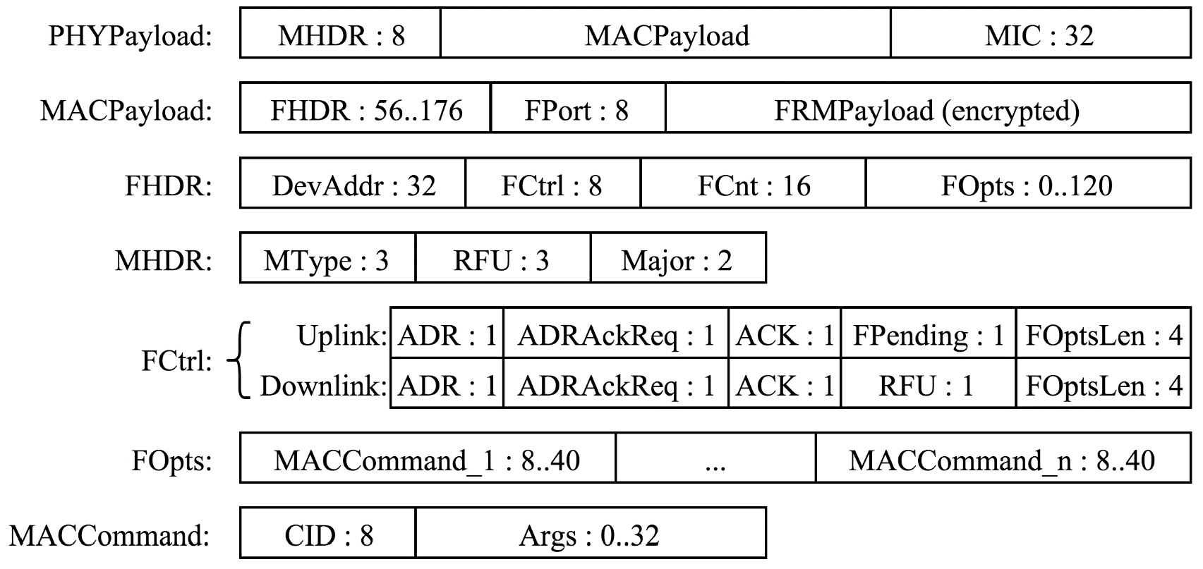
LoRa frame format

